Slide 1
Case Study in Lobbying: Lakimiesliitto and the National Court Administration
Mikko Salo, Eero Blåfield
Nordic Meeting, Visby, 1st September 2016

Slide 2
Why Independent Court Administration Matters?
Trias politica principle
Courts subordinates to Ministry of Justice
Members working in judiciary

Slide 3
Early development
In discussion since report 1978
Court administration in Nordics
SWE 1975 Domstolsverket
ICE 1998 Domstolarad
DEN 1999 Domstolsstyrelsen
NOR 2002 Domstolsadministrasjonen
FIN 2018 Tuomioistuinvirasto???
Independent administrations in Judiciary
The Office of the Prosecutor General 1997
Criminal Sanctions Agency 2010
National Administrative Office for Enforcement 2010

Slide 4
Katainen/Stubb Cabinet 2011-2015 – Laying the Foundation
Committee report for renewing administration of justice 2013
In 2014 we set a goal: National Court Administration (NCA) founded during election period 2015-2019
Discussion on 2015 national budget in fall of 2014
Constitutional Committee takes stance
Parliamentary committee on national security and future of rule of law
Ministry of Justice memo on renewing administration of courts 2015

Slide 5
Parliamentary Elections 2015 – Preparing for the Game
Independent court administration our primary goal in 2015 election lobbying and the ensuing cabinet negotiations
Trias politica → administrative efficiency
Several meetings with key party members
Election panel discussion with key lawyer politicians

Slide 6
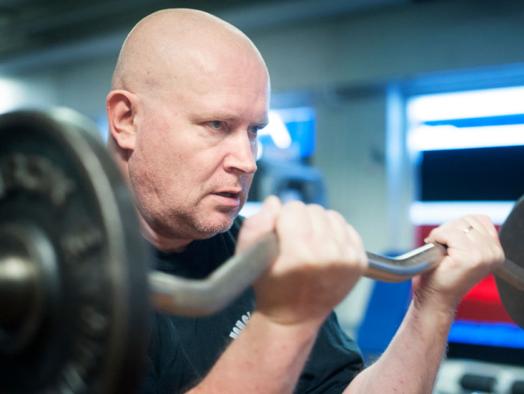
Parliamentary Elections 2015 – Establishing Relations to New Main Players
Win for the Centre-right parties
Sipilä Cabinet with Center, Finns and National Coalition Party
Minister of Justice and Employment from Finns party
Jari Lindström former paper mill worker
Interview article in Lakimiesuutiset in fall 2015, meetings with advisors and the minister

Slide 7
Producing New Information – Changing the Game
In October 2015 we started a project with Aula Research: an attempt to bring new, hopefully crucial information to the political dialogue on NCA
Aula interviewed 13 high-end experts → produced a report on the possible practical and fiscal ramifications of NCA
We edited the text into final form, produced calculations based on the expert interviews

Slide 8
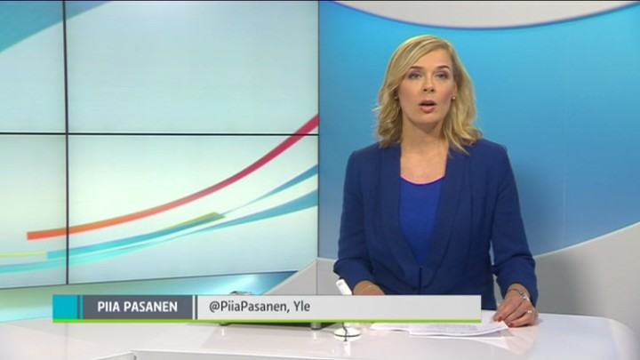
Publishing New Information – Hitting the Jackpot
Good working relationship with several justice reporters
Over the years we had discussed NCA with Päivi Happonen of Yleisradio and kept her updated → she became interested in Aula`s report
Hitting the media jackpot:
We gave exclusivity to Happonen and YLE
On 31st March we published the report
YLE ran it as one of their main topics of the day and in the 8:30 pm main news broadcast
In the broadcast Minister of Justice Jari Lindström promised to form a working group ASAP
NCA WAS TRULY IN BUSINESS!

Slide 9
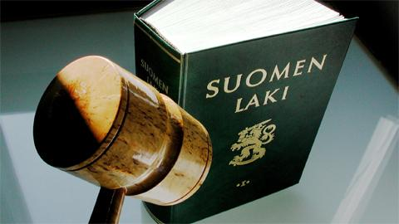
NCA Committee – Getting into Position
After the media jackpot Jari Lindström set up a committee to prepare the NCA
2+4+13 members, chairman Mikko Könkkölä, Helsinki Court of Appeal
How to influence the committee without a member from Lakimiesliitto?
JUKO – Negotiation Organisation for Public Sector Professionals → head shop steward Sari Aho
Our own working group
Going through the committee agenda before and after meetings → possible actions

Slide 10
The Near Future – What, Where, When, How…
Biggest questions in the Committee:
The power division between the ministry and NCA?
How many people work in NCA and where they come from?
Where will NCA be located?
What is the organisation of NCA going to be like?
Will the time table hold up?

Slide 11
Key Points in Succeeding – What We Have Learned (So Far)
Be patient – lobbying projects are long and arduous
Listen - Lobbying is as much listening as it is talking
Build trust – keep the relationships going even when nothing is happening
Be bold at the right time – Change the game, create your own momentum
Do your homework – know your figures and think ahead
Produce new information - and communicate it wisely in small and large scale
Offer Solutions – Politicians want to achieve, leave their mark
It is all about people – people make decisions, not organisations

